Slide 1
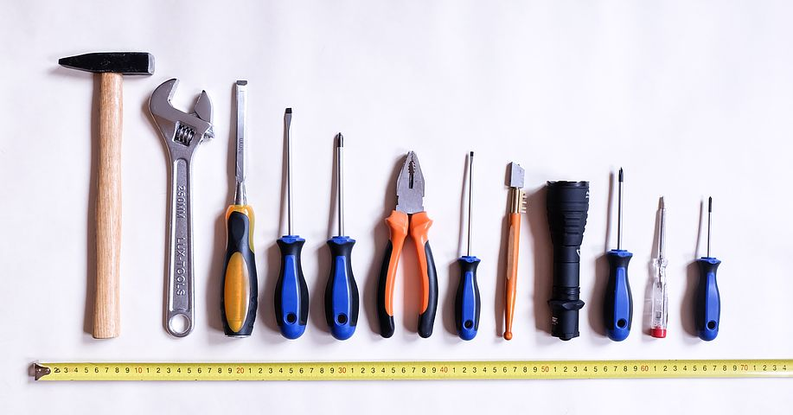
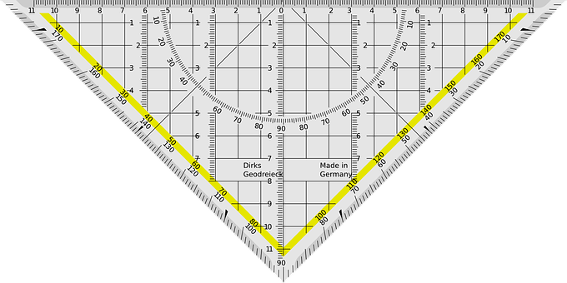
Building the Hardware
Activity # 3

Slide 2
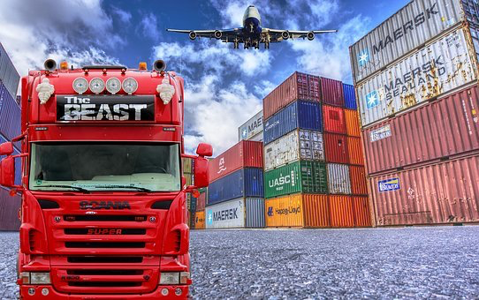
Learning Objective
Explore the parts of a supply chain to understand how all of the components came to be a part of the kit. We will also explore how different physical parts interact with each other to successfully build the car, create and test a circuit containing a power source, inputs, outputs and wires, while constructing a prototype of a self-driving vehicle using a scaled car kit, test the prototypes and make improvements.

Slide 3
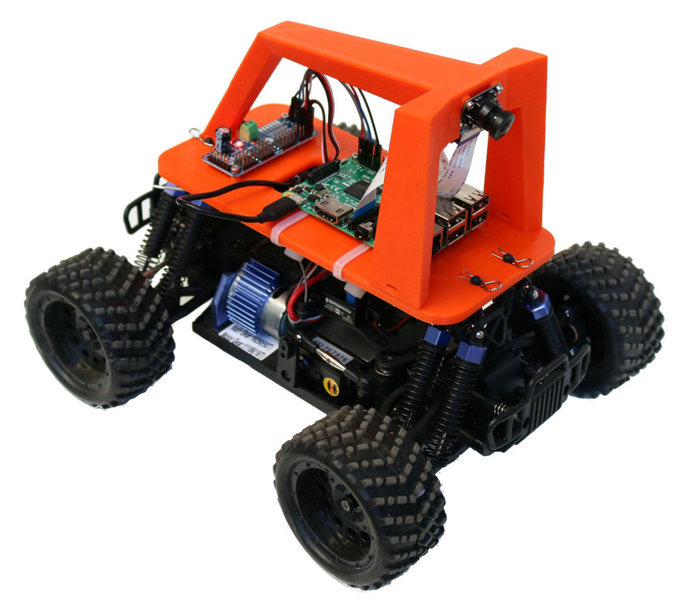
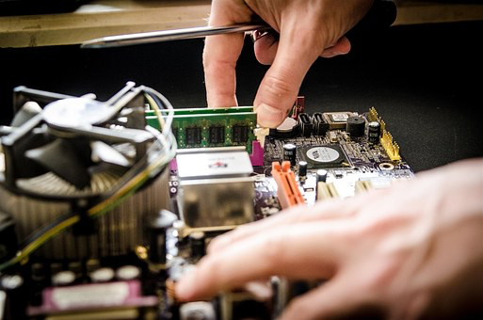
Skills To Be Learned
Parts of a supply chain
Hardware Assembly

Slide 4
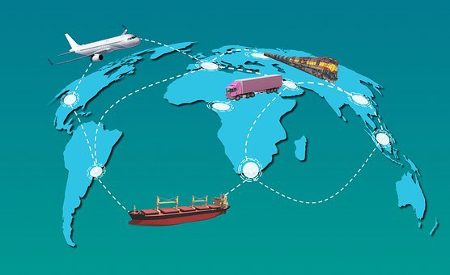
Activity Description
Students will begin by outlining the parts of a supply chain to understand how the different components that make up the hardware used to assemble the Donkey Car are made. After gaining an understanding of production, students will each receive a hardware kit that will contain all the components necessary to assemble the Donkey Car. Students will proceed to follow along Adam Conway’s assembly video “Donkey Car Assembly Video” to assemble their own car.

Slide 5
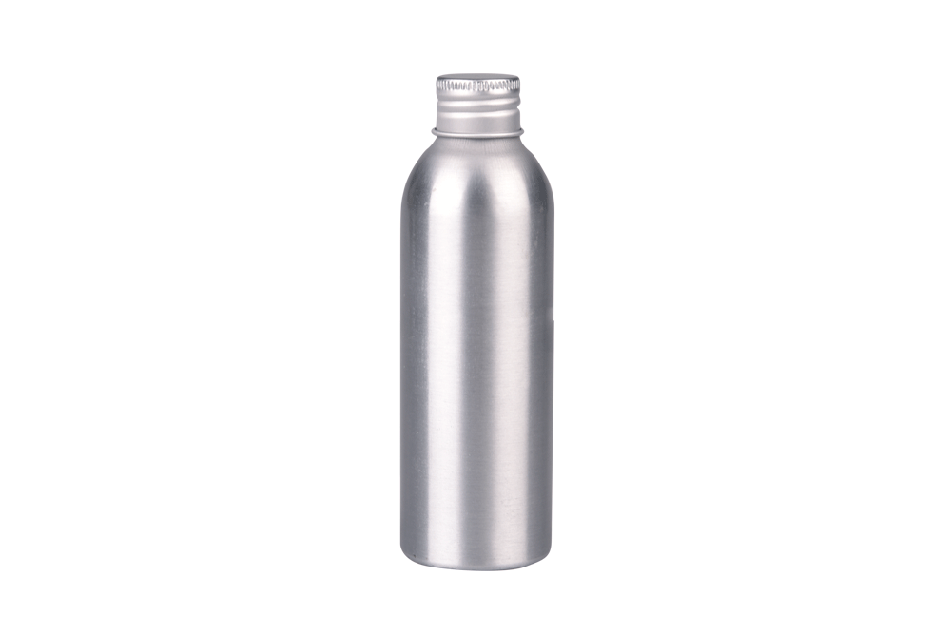
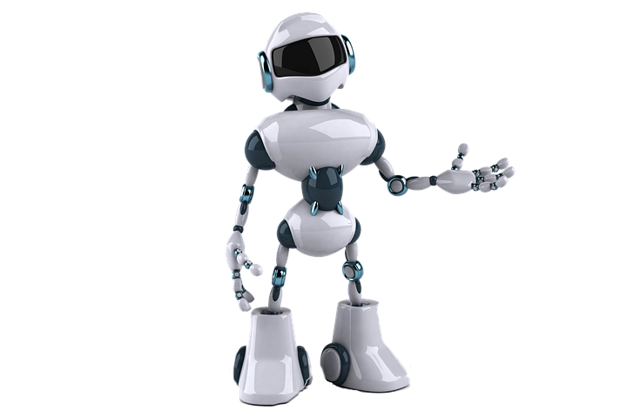
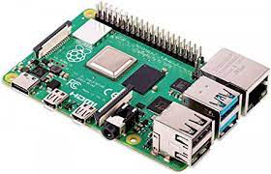
Activity
In your groups brainstorm the process necessary to assemble an aluminum water bottle
What are the materials necessary?
Where would you build it?
What kind of machinery would be necessary to build?
What would be the most efficient way to get it to the customer?
Discuss together as a class
Individually sketch what you believe the assembly process of a robot would look like

Slide 6
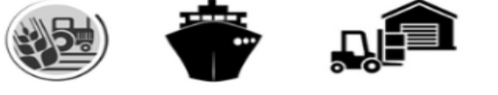


Supply Chain Managements
Procurement
Operations
Consumers
Raw Materials
Inbound Logistics
Goods In warehouse
Manufacturing
Outbound Warehouse
Outbound logistics
Consumer
Demand

Slide 7
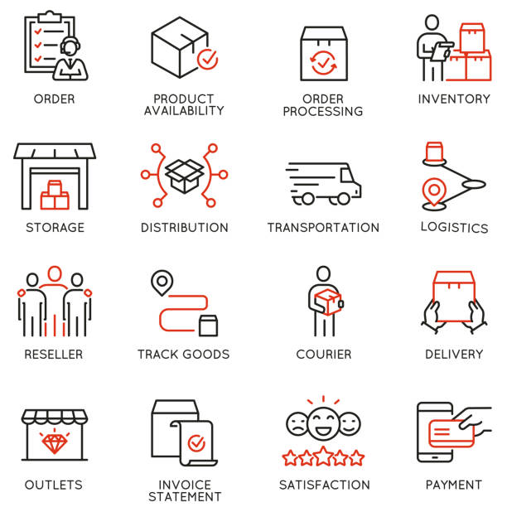
Supply Chain
Raw materials
unprocessed material, or primary commodity, is a basic material that is used to produce goods, finished products
Inbound Logistics
the way materials and other goods are brought into a company
Goods in Warehouse
Stored goods can include any raw materials, packing materials, spare parts, components, or finished goods associated with agriculture, manufacturing, and production.
Manufacturing
the making of articles on a large scale using machinery; industrial production.
Outbound Warehouse
The outbound flow in the warehouse begins with a request from released source documents to bring the items out of the warehouse location, either to be shipped to an external party or to another company location.
Outbound Logistics
Outbound logistics is the shipping out of finished products to customers from a warehouse or distribution center. It consists of the order fulfillment process including picking, packing, shipping, and delivery of a package.
Consumer
a person who purchases goods and services for personal use

Slide 8
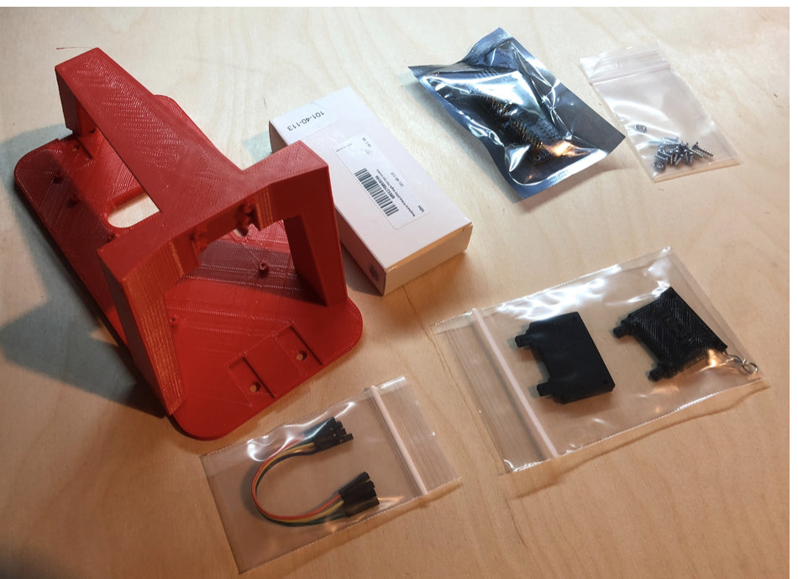
Hardware
Standard Donkey Car kit
Kit only includes:
3D Printed Chassis
Screws and Washers
Adapters (if needed, depending on model selected)
Camera
Servo Driver
Jumper cables
This kit does not include (purchased separately - refer to purchasing manual )
RC Car
Raspberry Pi
SD Card
Battery

Slide 9
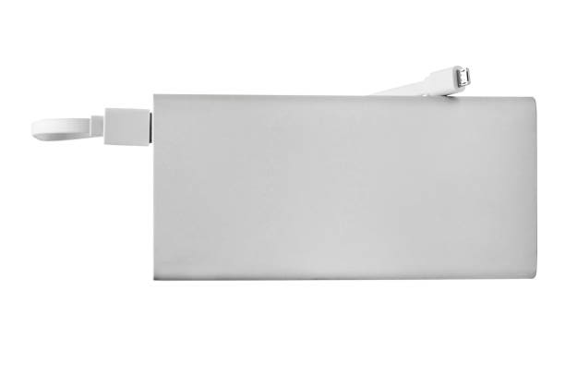
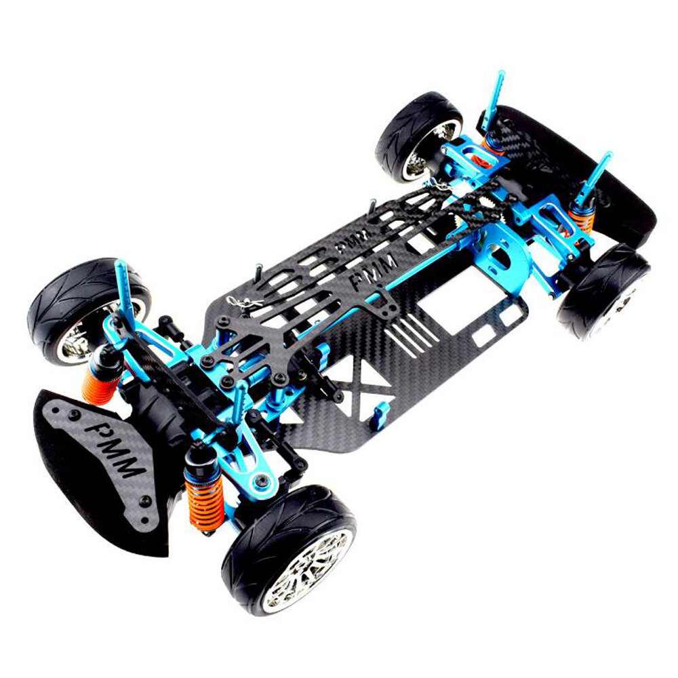
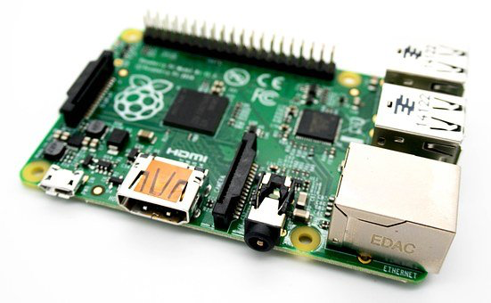

Battery
RC Car
SD Card (128GB)
Raspberry Pi

Slide 10
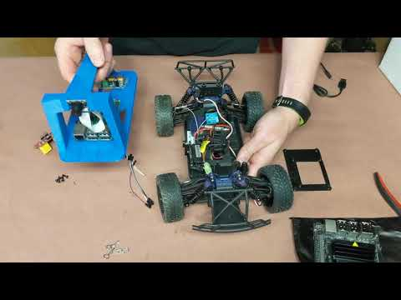
Hardware Assembly
Donkey Car Assembly Video
By: Adam Conway

